Slide 1
Qualitative Comparative Analysis and Fuzzy Set Method (2) Exercises for training in fsQCA at the Summer School “Fuzzy-sets and comparative data analysis” at the School of Advanced Social Studies’ Nova Gorica, Slovenia 28.07.2012 Prof. Zenonas Norkus, Department of Sociology, Faculty of Philosophy, Vilnius University, Lithuania http://www.fsf.vu.lt/index.php?option=com_vikl&task=vhome&v_user=zennor&Itemid=1149

Slide 2
Sources: Zenonas Norkus; Vaidas Morkevičius „Kokybinė lyginamoji analizė [Qualitative Comparative Analysis]“ (Kaunas, LiDA, 2011. ISBN: 978-9955-884-44-6). http://www.fsf.vu.lt/index.php?option=com_content&task=view&id=772&Itemid=1154&Itemid=1154 http://www.vaidasmo.lt/KLA/index.html http://www.lidata.eu/en/files/eng/training/textbooks/QCA_ad.pdf

Slide 3
How to (self)train in fs/QCA
1. Using function Graphs →Fuzzy→XY Plot investigate the relations of sufficiency and necessity of all antecedent conditions (positive and negative) to negative and positive outcomes. Look for highly consistent (consistency 0.95 and more) and non-trivial (coverage 0.7 and more) necessary conditions.
2. (Optional) repeat the investigation of the necessity conditions using Analyze →Necessary Conditions
3. Finding few consistency, repeat the analysis using lenient definitions of of sufficiency: „Xi (nearly, almost, quasi) sufficient condition of Yi, if membership scores of cases in Xi are smaller than their membership score in Yi : Xi – 0.1 ≤ Yi“ and necessity „Xi is (nearly,almost, quasi) necessary condition of Yi, if membership scores of cases in Xi is larger than their membership score in Yi : Xi +0.1 ≥ Yi“. For this goal, using Variables→Compute, construct new variables. Did this operation helped to solve inconsistency problems?
4. Make notice of the highly consistent necessary conditions to include them later into the „Intermediate solution“.
5. Construct configuration table, investigate the distribution of the inconsistencies across configurations (raws) and select optimal consistency threshold. Setting it too high, you risk to remain with table without positive outcomes. Selection of thresholds below 0.75 should be substantiated by some arguments.
6.Perform the Boolean minimization for positive and negative outcomes with only observed cases and including merely conceptually possible ones. If there were highly consistent necessary conditions, use them to search for intermediate solution. Notice and comment the consistency, raw and unique coverage numbers.
7.Using functions fuzzyand(x,...,), fuzzyor(x,...,) construct variables corresponding to subformula and formula for all 4 (6) solutions. Using function Graphs →Fuzzy→XY Plot investigate the consistency and coverage of these formula. Compare the observations with those in the output.
8.Using the detour via TOSMANA find the simplifying assumptions for positive and negative outcomes. Check them for possible contradictions and assess their plausibility.
9.Select different consistency thresholds, repeat minimization, compare and assess (discuss) the differences in findings, especially in the solution consistency and coverage indicators under different configuration consistency thresholds
10.Repeat the analysis using fs score adjusted for imprecise measurement (for sufficciency and necessity conditions)
11.(Optional) Supplement data set with new cases (your country!) and repeat analysis

Slide 4
Exercise Nr.1 Explaining Welfare State Generosity in the Advanced Industrial Democratic States (AIDAC’s) data set GenerWelfareState1 in http://www.fsf.vu.lt/index.php?option=com_content&task=view&id=772&Itemid=1154&Itemid=1154 (look to the bottom)
Source: Ragin, Charles C. (2000) Fuzzy-set Social Science. Chicago UP, p.206-308, grounded in the meta-analysis of the literature about the development of welfare state
Explanatory Problem: why AIDAC’s differ in the welfare state development?
Main Explanations: (1) Strong Left Parties (2) Strong Unions; (3) Corporatist Industrial System; (4) Sociocultural Homogeneity of Country
The goal of analysis: to compare explanatory performance of different approaches and explore whether (and which one) the pluralist conjunctural approach performs better

Slide 5
Exercise Nr.1 Explaining Welfare State Generosity in the Advanced Industrial Democratic States (AIDAC’s): explanatory conditions and outcome set
Outcome fuzzy set: genwelstat – the set of countries with generous welfare state.
The mean of the values of the two indexes of decommodification and liberalism constructed by famous researcher of welfare states Gosta Esping-Andersen are used as original data. These are not reproduced and no technical details about the calibration of the continuous fuzzy set membership scores provided in the source.
Explanatory conditions fuzzy sets:
strlefparties – the set of countries with strong left parties.
Membership score 0 – for countries with no participation of social-democratic parties in government after World War II. Membership score 1- for countries continuously ruled by such parties. Exact score depends on the duration of participation in government.
strunions – the set of countries with strong unions.
Membership score 1 attributed to a country with maximal unionization (Sweden). Countries with more than 50% labour force unionized receive membership score >0.5. Exact score of membership in this continuous fuzzy set depends on the percentage of the unionized labour force
corpindsys – the set of countries with corporatist industrial system.
The values of the corporatism index constructed by Gerhard Lehmbruch are used as original data. In this index, corporatism is measured as ordinal level (5 to 7 values) variable. The values are converted into 7 membership scores, so this fuzzy set is discrete.
socculhom – the set of socioculturally homogeneous countries
The mean values of the two indexes measuring the ethnic/racial and religious homogeneity of a country are used as original data.

Slide 6
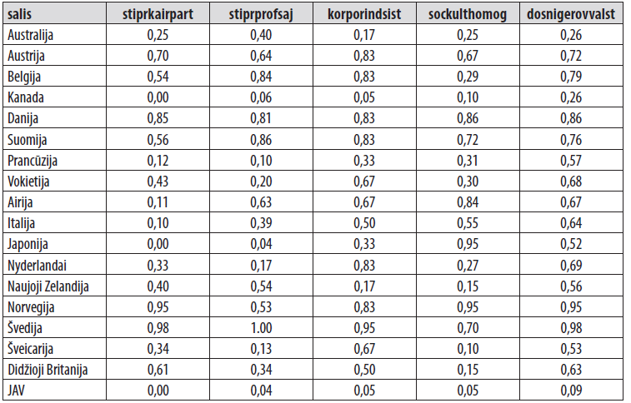
Exercise Nr.1 Explaining Welfare State Generosity in the Advanced Industrial Democratic States (AIDAC’s): data-set

Slide 7
Exercise Nr.2 Explaining Constitutional Control of the Executive Power (Government) data set ConstitutionalControl in in the Parliamentary and Semi-Presidential Democracies http://www.fsf.vu.lt/index.php?option=com_content&task=view&id=772&Itemid=1154&Itemid=1154 (look to the bottom)
Source:
Pennings P., 2003. „Beyond Dichotomous Explanations: Explaining Constitutional Control of the Executive with Fuzzy-Sets“, European Journal of Political Research, 42(4), 541–567.
The Problem: What are the main variations in the constitutional control of the executive in parliamentary democracies and how can these differences be accounted for?
Four competing hypotheses, based on dichotomies, explain the degree of this control by means of contrasting institutional settings:
(1) consensus democracy versus majoritarian democracy,
(2) (semi)presidentialism versus parliamentarism,
(3) thick versus thin constitutionalism
(4) established versus new democracies.
Goal: to test these hypotheses,
and then to look whether maybe the variations of constitutional control are not caused by one single factor or dimension, but by a combination of conditions that can be revealed more precisely with the help of fuzzy-sets rather than with crisp sets
Because discrete fuzzy sets are used, advised adjustment score for quasi/necessity and quasi/sufficiency is 0.17

Slide 8
Exercise Nr.2 Explaining Constitutional Control of the Executive Power (Government) in the Parliamentary and Semi-Presidential Democracies: explanatory conditions and outcome set
Outcome set fuzzy set: control - the formal powers of parliaments to constrain executive behavior .
Basically, there are three modes of interactions: the government dominates parliament, the parliament dominates government, and the parliament and government are balanced. The values of the index of the relative strengths of executive and legislative are used as original data for fuzzy set calibration. Index values range from -1.5 to +1.5.The creation of a seven-value fuzzy-set is straightforward because the composite index also has seven values. The crossover point (fuzzy set membership score 0.5) is assigned to countries where the executive-legislative relationship is in balance (i.e., where the index value = 0). The higher the membership score, the more governments are restricted in their room to maneuver.
Explanatory conditions fuzzy sets:
consdem – fuzzy set of consensus democracies
In consensus democracies, power-sharing is the central device used to enhance the cooperation between divergent minority groups in segmented societies. The opposite model is majoritarian democracy, which concentrates all political power in the winning party. Consensus democracies enlarge the room to maneuver of parliaments compared to majoritarian democracies, and their governments are expected to be weaker because they are built on coalitions. Majoritarian countries are characterized by weak parliaments and by executive dominance. The contrast between majoritarianism and consensus democracy is operationalized with the help of two variables: the effective number of parties and the type of government. The latter is indicated by the percentage of governments led by one party that takes all government seats. The higher this percentage, the higher the degree of majoritarianism. These variables are used to construct the index which measures the structural preconditions for consensus democracy. The values of this index (low for majoritarian, high for consensus democracies) are used as data to calibrate fuzzy membership scores.

Slide 9
Exercise Nr.2 Explaining Constitutional Control of the Executive Power (Government): explanatory conditions and outcome set (continued)
president – fuzzy set of semi-presidential democracies
It is assumed that the more powers are assigned to the president, the weaker is the parliament. The opposite of the presidential democracy is parliamentary democracy with no president or by a president elected by parliament and wielding only ceremonial power. The middle variant is semi-presidentialism, with popularly elected president, but the the government is responsible to parliament. To measure the power of President, Shugart and Carey’s index used. The values of this index range from ‘0’ to ‘17’ (maximum presidential power). The 27 countries with a president are subdivided into groups of four to five countries on the basis of the degree of presidential power (as reported by Shugart & Carey) and assigned diferent membership scores (no technical details reported).
newdem – fuzzy set of new democracies
It is expected that newly developed democracies distinguish themselves from established democracies by the many constitutional provisions installed in order to limit the power of executivesn established democracies. The division between established and new democracies is operationalized by the year in which a democratic regime was established. The fuzzy set membership score ‘0’ is assigned to the older democracies and ‘1’ to the newest democracies. A score of ‘0.5’ is assigned to regimes that were established between 1945 and 1950.
rigidcons – fuzzy set of countries with rigid constitutions
Rigid (thick) constitutions restrict the room to maneuver of parliaments (but also of governments). Thin (characteristic for majoritarian democracies) constitutions enhance strong legislatures. countries with an unwritten constitution (Israel, New Zealand, the United Kingdom) are scored ‘0’ whereas extreme rigid countries where the amendment of the constitution is loaded with many requirements are scored ‘1’. For membership scoring of the countries in-between, the values of the Woldendorp and Lijphart indexes used.
NB: Included are solely parliamentary or semi-presidential democracies where the government is (fully) responsible to parliament. Therefore, U.S. and most Latin American countries with their pure presidentialism is not included into the data-seta. Under pure presidentialism the popularly elected President is the Head of the government (Minister cabinet; no Prime Minister office), not just the Head of State, so he/she is cannot be a power exercising constitutional control over government

Slide 10
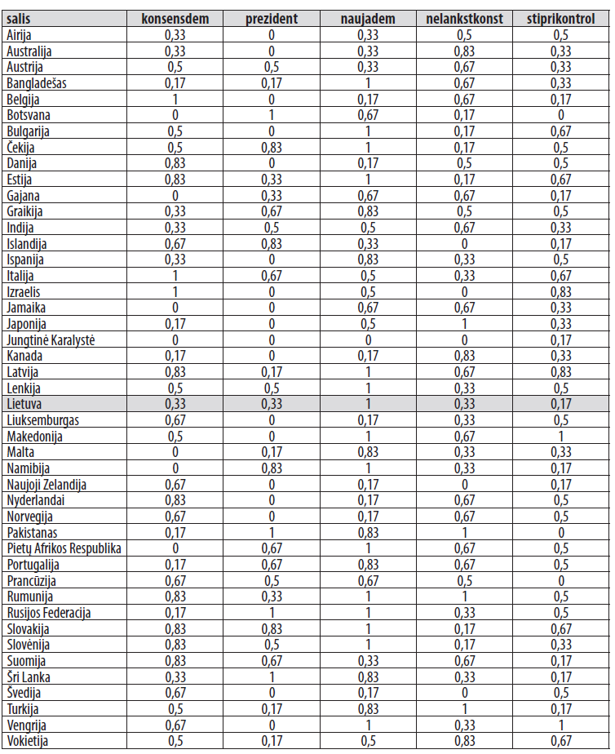
Exercise Nr.2 Explaining Constitutional Control of the Executive (data set)

Slide 11
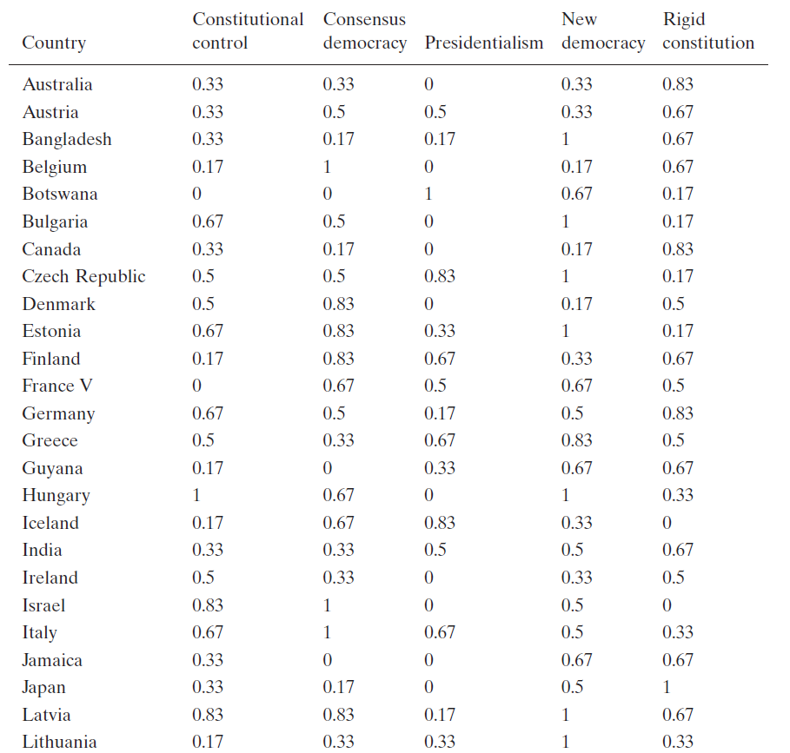
Exercise Nr.2 Explaining Constitutional Control of the Executive (data set)

Slide 12
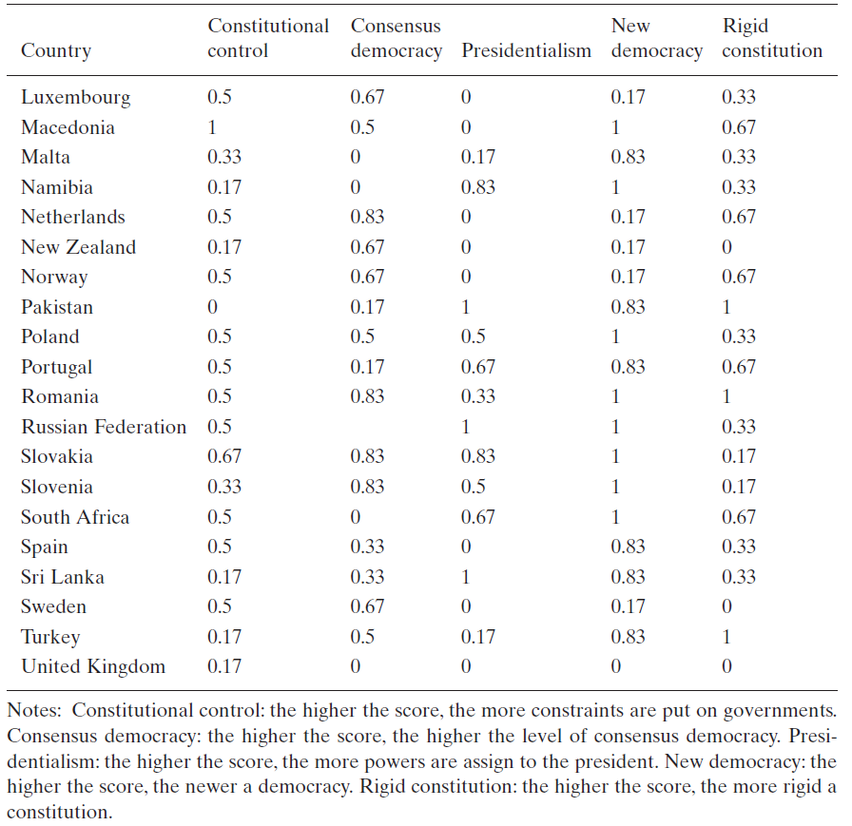
Exercise Nr.2 Explaining Constitutional Control of the Executive (data set) - continued

Slide 13
Pennings Findings
Sufficient conditions of high levels of constitutional control:
(1) presidentialism • CONSENSUS DEMOCRACY • NEW DEMOCRACY,
(2) presidentialism • CONSENSUS DEMOCRACY • rigid constitution.
These two expressions can be minimized to this solution:
presidentialism • CONSENSUS DEMOCRACY • (NEW DEMOCRACY + thick constitution)
(a high level of formal constitutional control of the executive is found in countries with: (1) no or weak presidentialism, (2) a consensus democracy and (3) either a new democracy or the absence of a thick constitution).
The fuzzy-set analysis leads to the conclusion that, in order to account for the degree of constitutional control, all four causal conditions appear to be relevant and none of them forms an fully adequate explanation in itself. However, there is a serious restriction – namely that the causal expression only confirms the direction of the relationships that are implied by the four hypotheses in a ‘quasi-mode’. Despite this confinement, the main findings do make sense and confirm the assumptions underlying the four main hypotheses on which the analysis is based. The absence of (semi)presidentialism enhances constitutional control because presidents are inclined to concentrate executive and legislative powers which weaken parliaments (Linz’s hypothesis). Consensus democracies can, in some instances, be sufficient for constitutional control because power-sharing gives parliaments a say in collective decisionmaking as is hypothesized by Lijphart), but it does so only in combination with weak or no presidentialism. This combination confirms Lijphart’s assumption that consensus democracy virtually rules out presidential or semipresidential forms of government. The absence of a rigid constitution gives parliaments more room to maneuver and is therefore conducive to (but not decisive for) constitutional control. Finally, new democracies are inclined to assign significant formal powers to parliaments and/or Heads of State in order to prevent a fallback into authoritarianism. However, none of these four isolated factors is strictly necessary or sufficient.
Schneider‘s re-analysis (in textbook): presidentialism • NEW DEMOCRACY • rigid constitution; CONSENSUS DEMOCRACY • presidentialism • NEW DEMOCRACY , or presidentialism • NEW DEMOCRACY (rigid constitution + CONSENSUS DEMOCRACY) (consistency 0.85)
Schneider on negatives outcomes: (consistency near 1)
CONSENSUS DEMOCRACY • PRESIDENTIALISM •RIGID CONSTITUTION; consensus democracy• PRESIDENTIALISM •NEW DEMOCRACY •rigid constitution
Membership scores 0.5 changed to 0.55

Slide 14
Exercise Nr. 3 Explaining IMF Protests (mass protests against austerity measures imposed by International Monetary Fund as condition for a new loan package and the restructuring of existing debt) data set IMFRiots.csv http://www.fsf.vu.lt/index.php?option=com_content&task=view&id=772&Itemid=1154&Itemid=1154 (look to the bottom of page)
Source: Ragin, Charles C. (2000) Fuzzy-set Social Science. Chicago UP, p.206-308, grounded in own work: Walton J., Ragin C. C., 1990. “Global and National Sources of Political Protest: Third World Responses to the Debt Crisis”, American Sociological Review, 55(6), 876–890.
The goal – to explain the difference in the reaction to the IMF imposed austerity measures between 1978-1988, assessing and comparing the relevance and performance of the different factors suggested in the research literature

Slide 15
Exercise Nr. 3 Explaining IMF Protests: explanatory conditions and outcome set (7 score discrete fuzzy sets used)
Outcome fuzzy set: protest – the set of countries with protest against austerity policies imposed by IMF in 1978-1988.
7 levels of membership. The scores of 0.5 and more receive countries with violence and riots reported in the „high brow“ Western mass media. High scores receive countries with severe violence, involving deaths, broad spread (many cities etc.). The scores under 0.5 receive countries with peaceful demonstrations, labour strikes and other non-violent forms of protest
Explanatory conditions fuzzy sets:
pressure – the pressure of the International Monetary Fund.
The values of the index of IMF pressure are used as original data. To calculate the values of this index the evidence on number of debt renegotiations and restructurings jointly with information about actions signalling IMF conditionality are used. No technical details about the calibration of the discrete fuzzy set membership scores provided.
urban – the set of urbanized countries.
The use of this variable is suggested by the finding of the quantitative research that the corresponding variable explains much relevant variation (urban populations suffer the brunt of austerity measures, and they are easier to mobilize for collective action). The percentage living in urban areas translated into degrees of membership in the set of membership into the set of urbanized countries.
hardship – the set of countries experiencing economic hardship (1978-1988).
To assess countries’ degree in this fuzzy set, a variety of economic indicators were examined, focusing on those relating to inflation and consumer prices from the late 1970s through the mid-1980s.

Slide 16
Exercise Nr. 3 Explaining IMF Protests: explanatory conditions and outcome set (discrete fuzzy sets used) Continued
depend - the set of countries dependent on foreign investment.
To assess countries’ degree in this fuzzy set, various sources detailing the amount and sectorial distribution of foreign capital formation, especially based in developed countries, were used
liberal – the set of countries that experienced political liberalization (1978-1988).
Membership in this set was scaled according to the number of civil and political rights gained over the decade from 1978 to 1988. Countries that experienced a net decrease or no increase in political and civil rights were assigned membership scores 0 in this set. Rationale: maybe under conditions of liberalization people are more prone to rebel, while under the dictatorship they quietly endure?
activism- the set of countries with activist governments.
Membership in this set is based on the size of the public sector (government revenue as a proportion of gross domestic product (GDP), the role of direct taxation in public finance, and the accumulated years of experience with provision of social security programs.

Slide 17
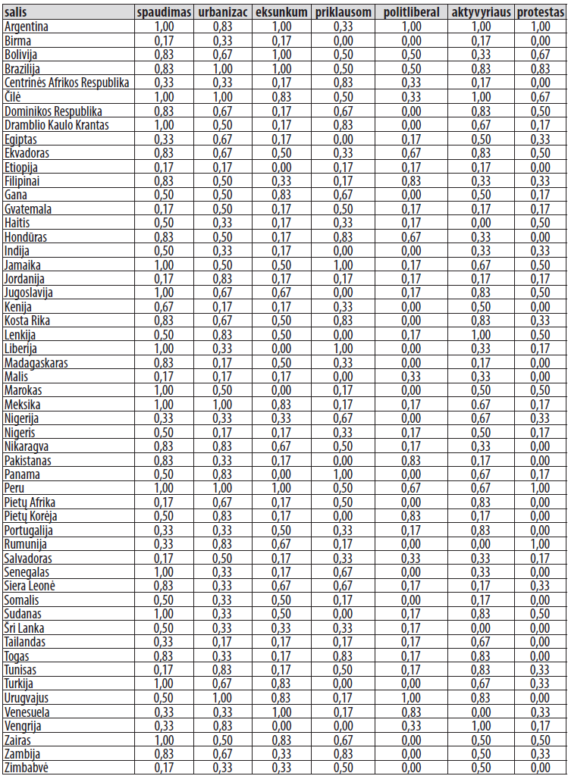
Exercise Nr. 2.Explaining IMF Protests Data set

Slide 18
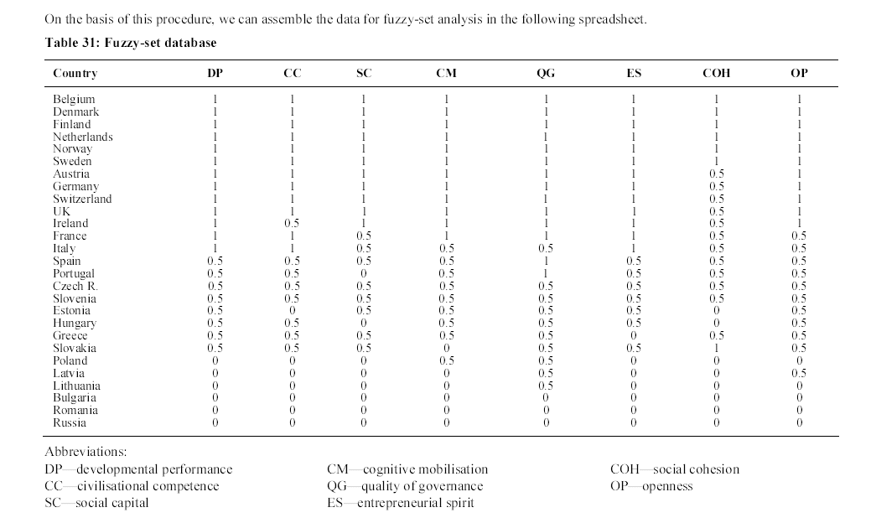
Adam, Frane; Makarovič, Matej; Rončevič, Borut; Tomšič, Matevž. 2005. The Challenges of Sustained Development. The Role of Socio-Cultural Factors in East-Central Europe. Budapest: CEU Press. Fuzzy set data-base

Slide 19
Concluding Observations
When crisp sets are compared with fuzzy-sets it turns out that they share many qualities since both are able to capture complexity, examine various determinants at the same time, enable multicausal explanation, allow one to study diversity, identify constellations of causal conditions, etc. The main drawback of crisp sets is the loss of information which leads to a less reliable, but not necessarily more parsimonious, outcome if compared with fuzzy sets.
Like crisp sets, fuzzy-sets also overlap with qualitative analysis in the sense that both have an eye for peculiarities of individual cases, especially those that are not consistent with the hypothesized causal effect.

